Slide 1
Time Value of Money
Dr. Sarveshwar Kumar Inani
sarveshwarinani@wilp.bits-pilani.ac.in

Slide 2
Time Value of Money (TVM)
Investing and financing decisions in a business create cash flows (CF) at different point in time. For example, invest in a machine/equipment today and cash flows will be generated for next 10 years. CF today and 10 years later are same?
Money has time value. A rupee today is more valuable than a rupee 10 year later. Why??????. There are several reasons:
Individuals, in general, prefer current consumption to future consumption.
Capital can be employed productively to generate positive returns.
In an inflationary period, a rupee today represents a greater real purchasing power than a rupee a year hence.
TVM concept is very useful in valuation of any financial asset (Debt/Bond/Preference Shares)

Slide 3
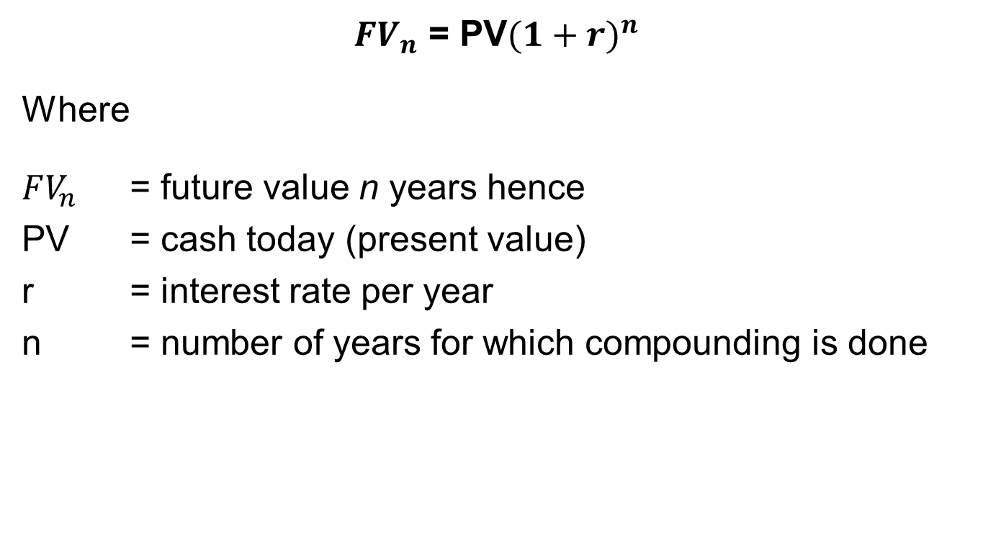
Future Value of a Single Amount
$FV_{n}$ = PV${(1+r)}^{n}$
Where
$FV_{n}$ = future value n years hence
PV = cash today (present value)
r = interest rate per year
n = number of years for which compounding is done

Slide 4
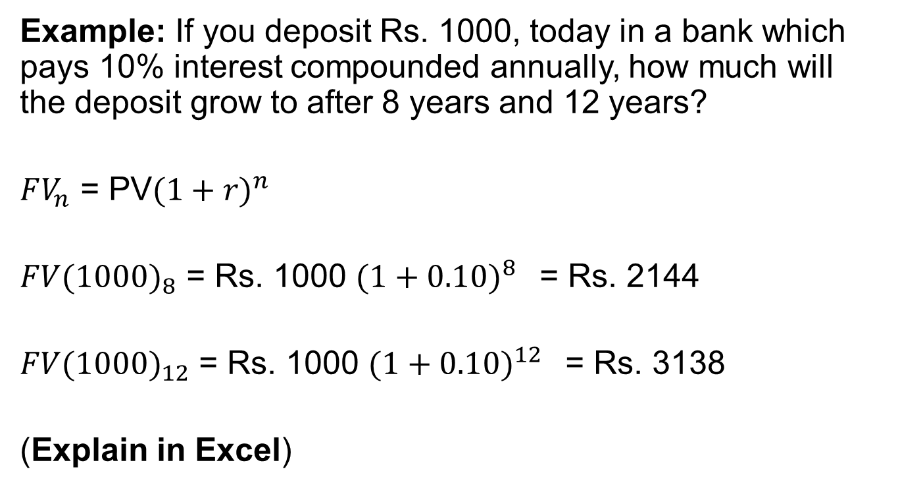
Example of FV:
Example: If you deposit Rs. 1000, today in a bank which pays 10% interest compounded annually, how much will the deposit grow to after 8 years and 12 years?
$FV_{n}$ = PV${(1+r)}^{n}$
$FV({1000)}_{8}$ = Rs. 1000 ${(1+0.10)}^{8 }$ = Rs. 2144
$FV({1000)}_{12}$ = Rs. 1000 ${(1+0.10)}^{12 }$ = Rs. 3138
(Explain in Excel)

Slide 5
Doubling Period
Rule of 72 :
According to this rule of thumb the doubling period is obtained by dividing 72 by the interest rate. For example, if the interest rate is 8%, the doubling period is about 9 years (72/8). It gives us an approximation, not the exact answer. For exact answer, we should always use calculator.
Q1. If interest rate is 6%, how long will it take to doble the money. (72/6=12 years)
Q2. If money has doubled in 7 years in an investment scheme, what is possible rate of return? (72/7=10.3 years approx.)

Slide 6
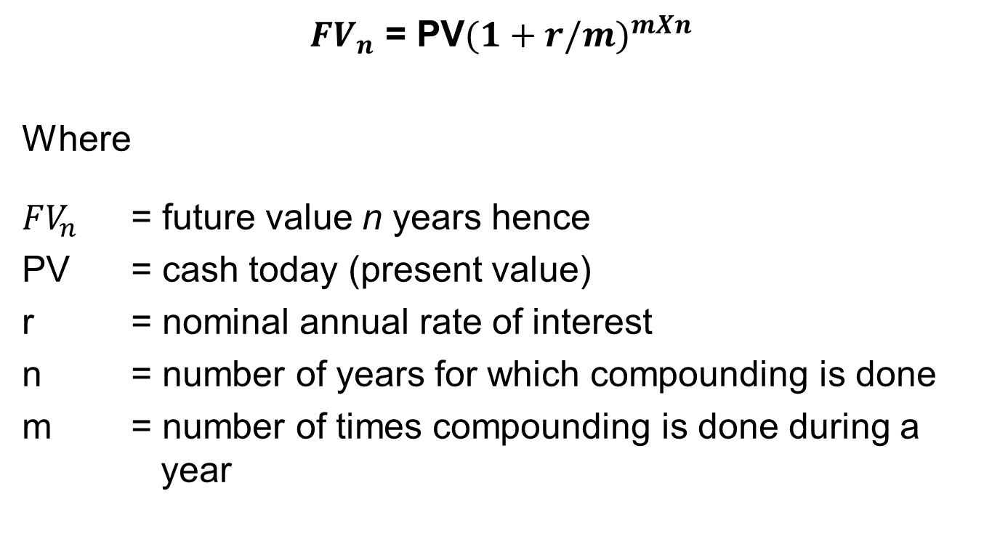
Shorter Compounding Period
$FV_{n}$ = PV${(1+r/m)}^{mXn}$
Where
$FV_{n}$ = future value n years hence
PV = cash today (present value)
r = nominal annual rate of interest
n = number of years for which compounding is done
m = number of times compounding is done during a year

Slide 7
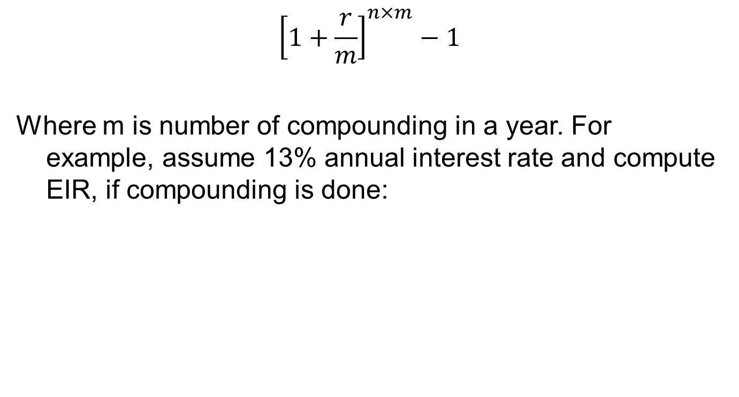
Effective Interest Rate
$${\left[1+\frac{r}{m}\right]}^{n×m}−1$$
Where m is number of compounding in a year. For example, assume 13% annual interest rate and compute EIR, if compounding is done:
Compounding done: | Number of componding in a year (m) | EIR
Half-yearly | 2 | 13.42%
Quarterly | 4 | 13.65%
Monthly | 12 | 13.80%
Weekly | 52 | 13.86%

Slide 8
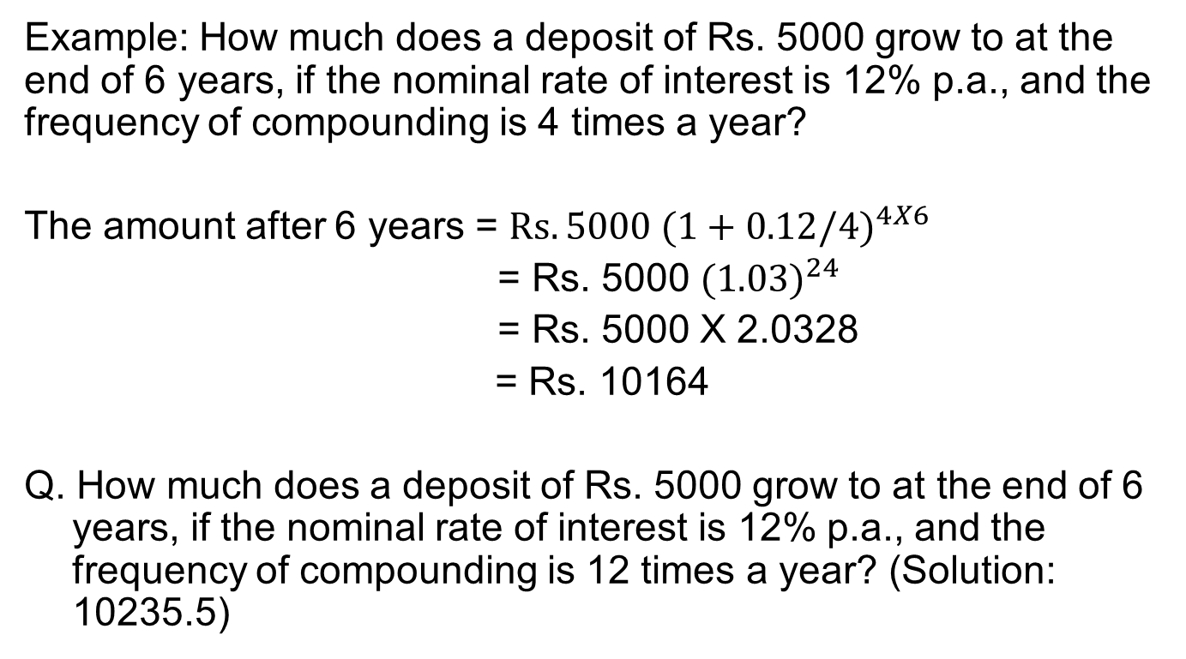
Value of Shorter Compounding Period
Example: How much does a deposit of Rs. 5000 grow to at the end of 6 years, if the nominal rate of interest is 12% p.a., and the frequency of compounding is 4 times a year?
The amount after 6 years = $Rs. 5000 {(1+0.12/4)}^{4X6}$
= Rs. 5000 ${(1.03)}^{24}$
= Rs. 5000 X 2.0328
= Rs. 10164
Q. How much does a deposit of Rs. 5000 grow to at the end of 6 years, if the nominal rate of interest is 12% p.a., and the frequency of compounding is 12 times a year? (Solution: 10235.5)

Slide 9
Future Value of An Annuity
An annuity is a series of periodic cash flows of equal amounts. For example, the premium payment of life insurance policy, Home Loan EMI.
When the cash flows occur at the end of each period the annuity is called a regular annuity.
When the cash flows occur at the beginning of each period the annuity is called an annuity due.

Slide 10
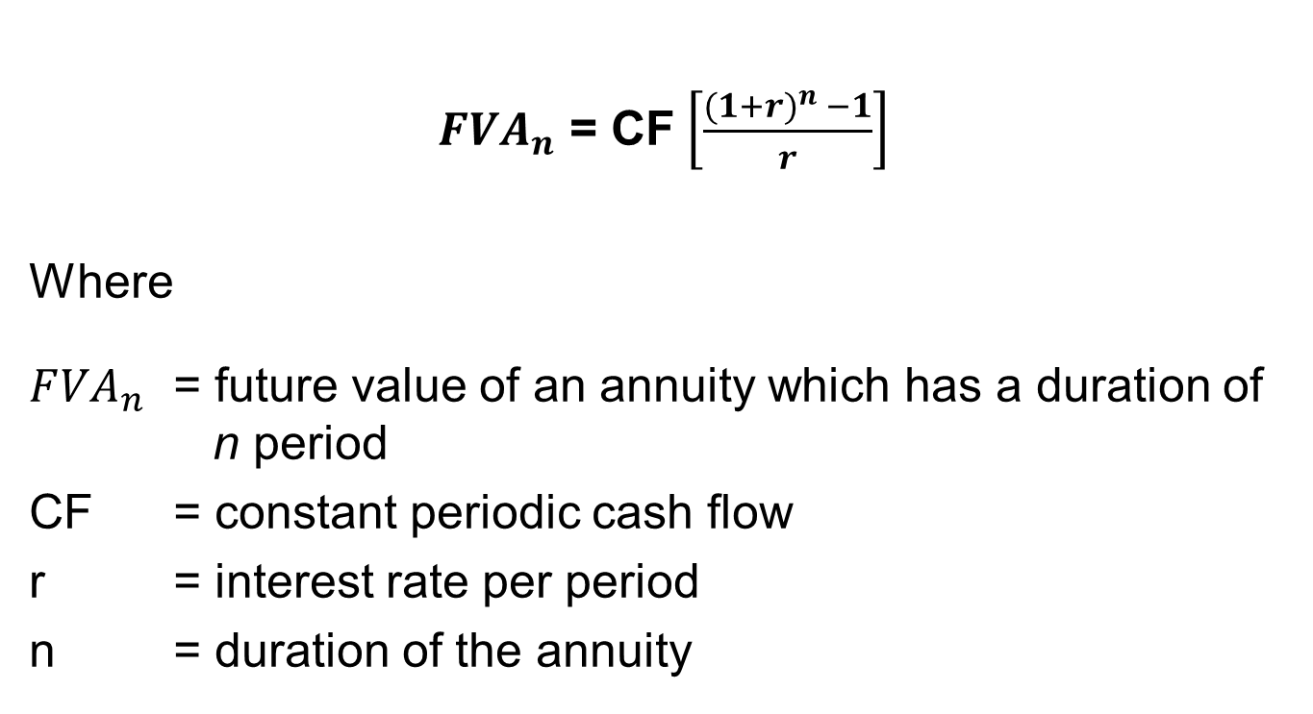
Future Value of An Annuity
$F{VA}_{n}$ = CF$\left[\frac{{(1+r)}^{n} −1}{r}\right]$
Where
$F{VA}_{n}$ = future value of an annuity which has a duration of n period
CF = constant periodic cash flow
r = interest rate per period
n = duration of the annuity

Slide 11
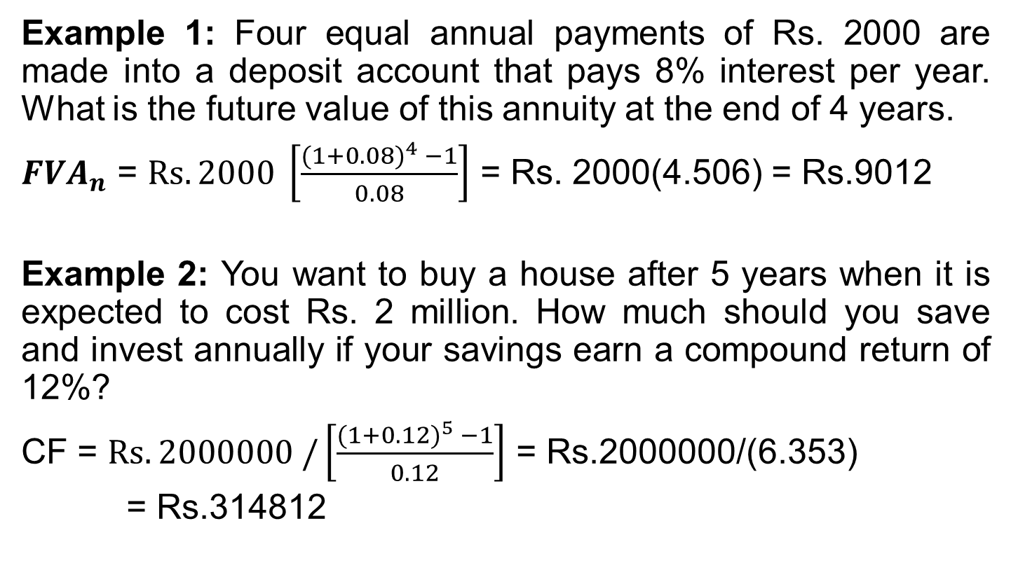
Future Value of An Annuity
Example 1: Four equal annual payments of Rs. 2000 are made into a deposit account that pays 8% interest per year. What is the future value of this annuity at the end of 4 years.
$F{VA}_{n}$ = $Rs. 2000 \left[\frac{{(1+0.08)}^{4} −1}{0.08}\right]$ = Rs. 2000(4.506) = Rs.9012
Example 2: You want to buy a house after 5 years when it is expected to cost Rs. 2 million. How much should you save and invest annually if your savings earn a compound return of 12%?
CF = $Rs. 2000000 /\left[\frac{{(1+0.12)}^{5} −1}{0.12}\right]$ = Rs.2000000/(6.353)
= Rs.314812

Slide 12
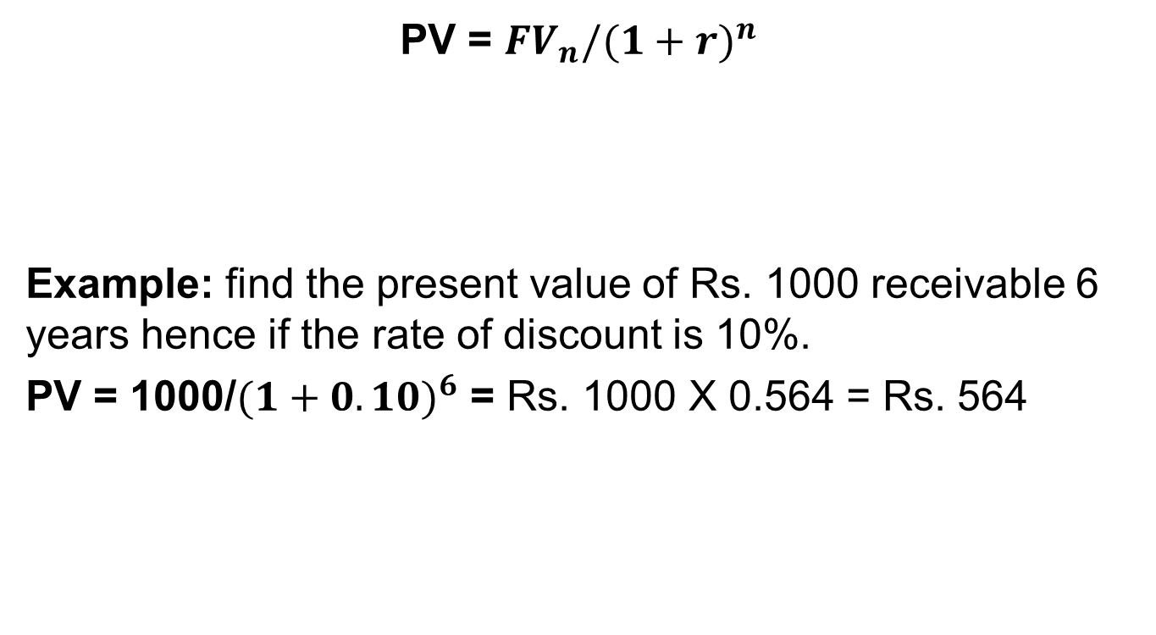
Present Value of a Single Amount
PV = ${FV}_{n}/{(1+r)}^{n}$
Example: find the present value of Rs. 1000 receivable 6 years hence if the rate of discount is 10%.
PV = 1000/${(1+0.10)}^{6}$ = Rs. 1000 X 0.564 = Rs. 564

Slide 13
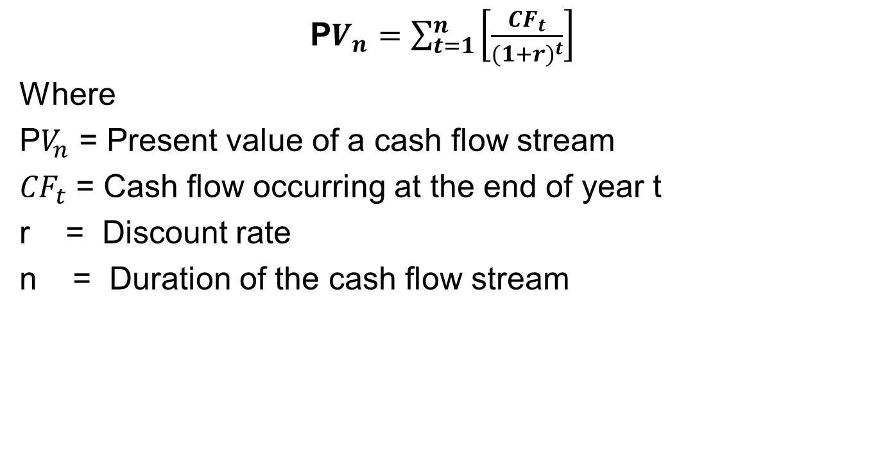
Present Value of an Uneven Series
P$V_{n}=\sum_{t=1}^{n}{\left[\frac{{CF}_{t}}{{(1+r)}^{t}}\right]}$
Where
P$V_{n}$ = Present value of a cash flow stream
${CF}_{t}$ = Cash flow occurring at the end of year t
r = Discount rate
n = Duration of the cash flow stream

Slide 14
Present Value of an Uneven Series
Example: Calculate present value of the following cash flow stream if the discount rate is 12%
Show in excel.
Year | 1 | 2 | 3 | 4 | 5 | 6 | 7 | 8
Cash Flow | 1000 | 2000 | 2000 | 3000 | 3000 | 4000 | 4000 | 5000

Slide 15
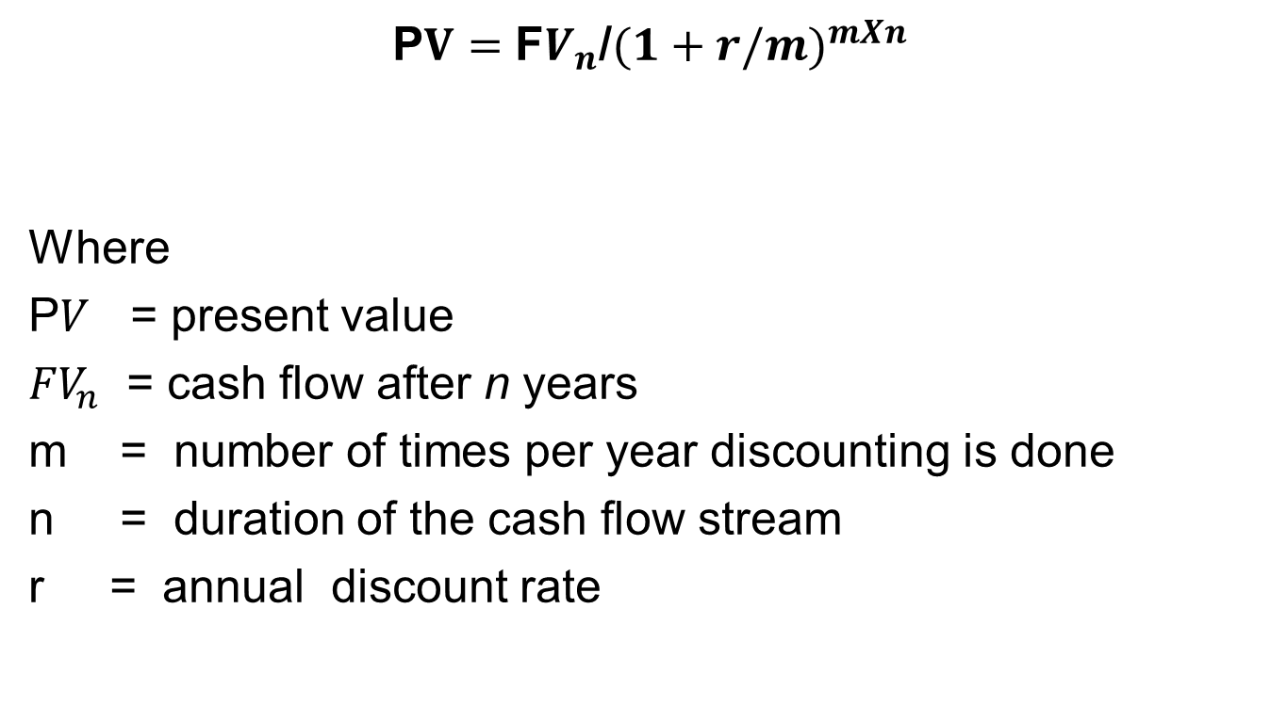
Shorter Discounting Period
P$V=$ F$V_{n}$/${(1+r/m)}^{mXn}$
Where
P$V$ = present value
${FV}_{n}$ = cash flow after n years
m = number of times per year discounting is done
n = duration of the cash flow stream
r = annual discount rate

Slide 16
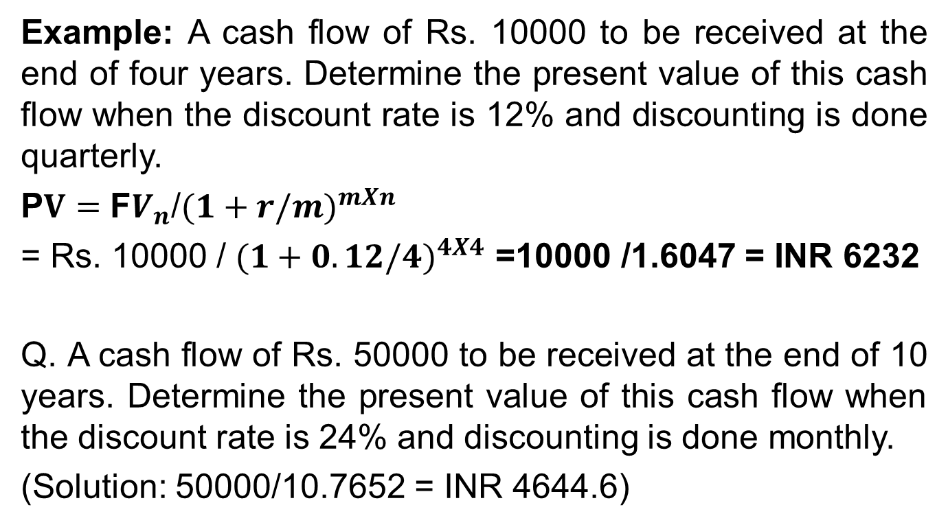
Shorter Discounting Period
Example: A cash flow of Rs. 10000 to be received at the end of four years. Determine the present value of this cash flow when the discount rate is 12% and discounting is done quarterly.
P$V=$ F$V_{n}$/${(1+r/m)}^{mXn}$
= Rs. 10000 / ${(1+0.12/4)}^{4X4}$ =10000 /1.6047 = INR 6232
Q. A cash flow of Rs. 50000 to be received at the end of 10 years. Determine the present value of this cash flow when the discount rate is 24% and discounting is done monthly.
(Solution: 50000/10.7652 = INR 4644.6)

Slide 17
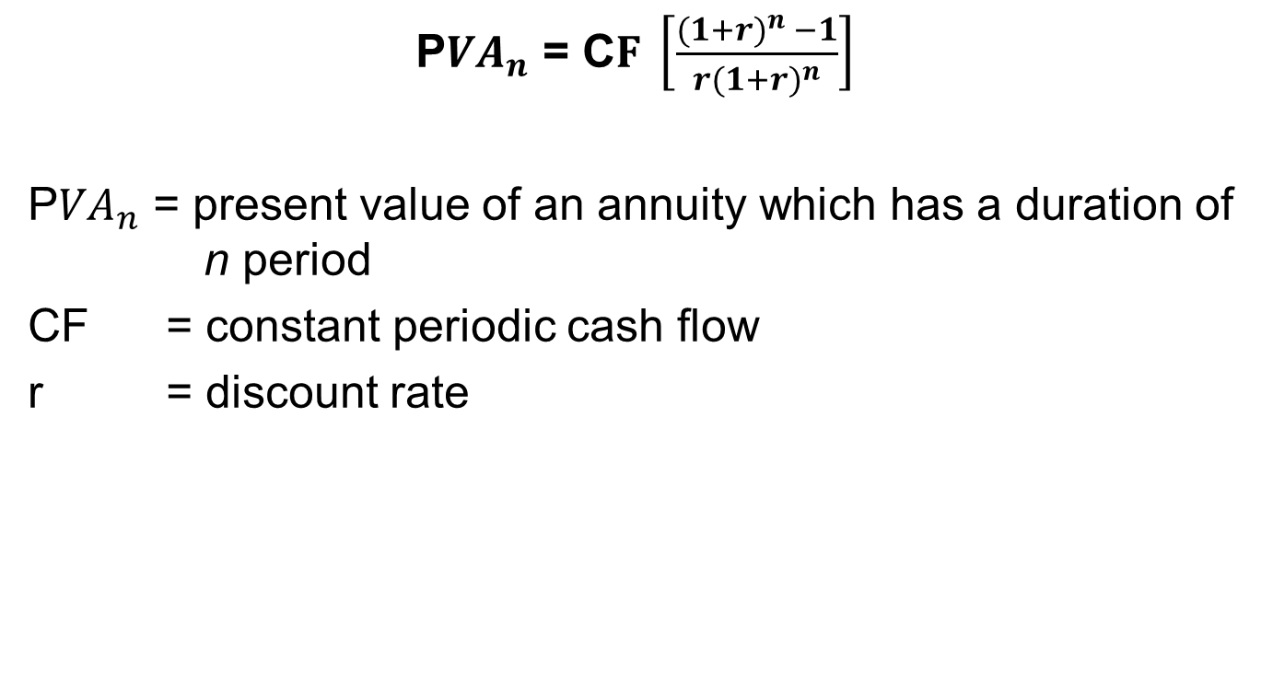
Present Value of Annuity
P${VA}_{n}$ = C$F \left[\frac{{(1+r)}^{n} −1}{r{(1+r)}^{n}}\right]$
P${VA}_{n}$ = present value of an annuity which has a duration of n period
CF = constant periodic cash flow
r = discount rate

Slide 18

Present Value of Annuity
Example: what is the present value of a 4 year annuity of Rs. 10000 discounted at 10%? (Refer to Excel)
P${VA}_{n}$ = 10000 X $[\frac{1.1^{4}−1}{0.1∗1.1^{4}}$] = INR 31698.65

Slide 19
Present Value of a Perpetuity
A perpetuity is an annuity of infinite duration (No maturity).
Present Value of a Perpetuity = CF/r
Such investments products are rare. Example, Perpetual bonds.
Still this concept is very useful in finance, such as it is used in dividend discount model of valuation.
Q. What is the present value of a perpetuity that has $300 annual payments using an 8% discount rate? (Solution 300/0.08= $3750

Slide 20
Time Value of Money : Practice Problems
Problem 1: If you invest Rs. 5000 today at a compound interest of 9 per cent, what will be its future value after 75 years? (Solution: 3,205,954.47)
Problem 2: If the interest rate is 12 per cent, what are the doubling period as per the rule of 72? (6 years)
Problem 3: A borrower offers 16 per cent annual rate of interest with quarterly compounding. What is the effective rate of interest? (16.99%)

Slide 21
1.5 Time Value of Money : Problems
Problem 4: Fifteen annual payments of Rs. 5000 are made into a deposit account that pays 14 per cent interest per year. What is the future value of this annuity at the end of 15 years. (219,212.07)
Problem 5: What is the present value of Rs. 1000000 receivable 60 years from now, if the discount rate is 10 percent? (3284.27)

Slide 22

Equated Monthly Instalment (EMI)
EMI can be calculated using PVA formula:
P${VA}_{n}$ = C$F \left[\frac{{(1+r)}^{n} −1}{r{(1+r)}^{n}}\right]$
CF =$\frac{P{VA}_{n}}{\left[\frac{{(1+r)}^{n} −1}{r{(1+r)}^{n}}\right]}$

Slide 23

EMI Example
Shyam takes a housing loan of Rs. 1000000 carrying an interest of 1 per cent per month. The loan is to be repaid over 180 months. What is the EMI?
Cf =$\frac{P{VA}_{n}}{\left[\frac{{(1+r)}^{n} −1}{r{(1+r)}^{n}}\right]}$= $\frac{1000000}{83.321}$ = Rs. 12001.68 (Show in Excel)

Slide 24
THANK YOU!!!

